Slide 1

Application Layer (Electronic Mail &DNS)
Lecture 4 | Part 1 of 4 | CSE421 – Computer Networks
Department of Computer Science and Engineering School of Data & Science

Slide 2

Objectives
Principles of network applications
Web and HTTP
Electronic mail
SMTP, POP3, IMAP
DNS
P2P applications
Video streaming and content distribution networks
Socket programming with UDP and TCP

Slide 3
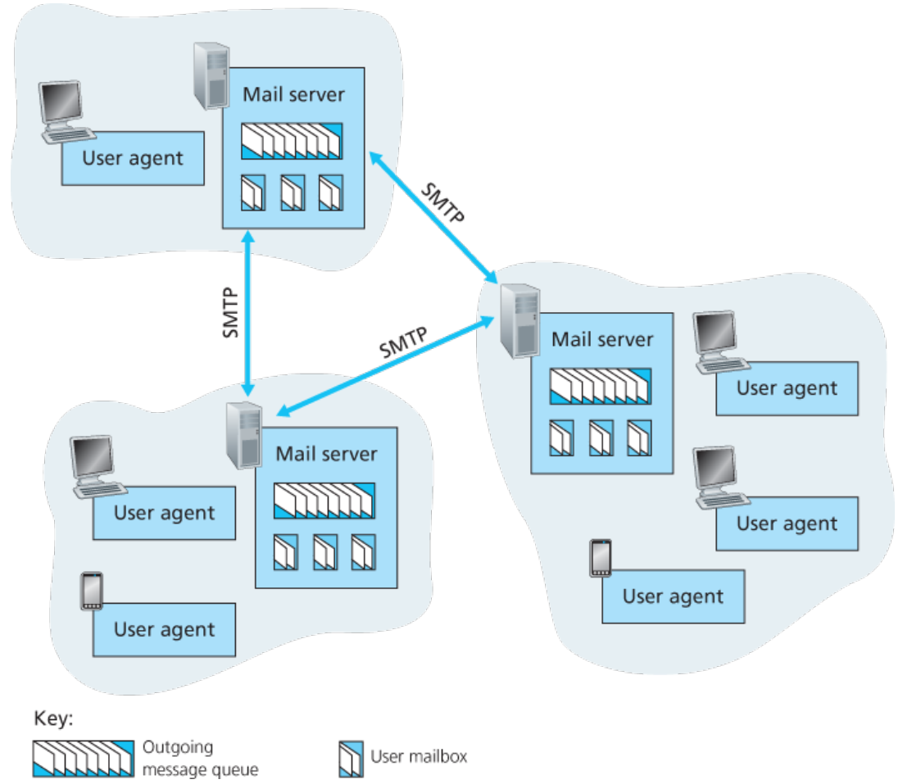
Electronic mail
Major components:
User agents
Mail servers
Simple mail transfer protocol: SMTP
User Agent
a.k.a. “mail reader”
Composing, editing, reading mail messages
e.g., Outlook, Thunderbird, iPhone mail client
Outgoing, incoming messages stored on server

Slide 4
Electronic mail: mail servers
Mail servers:
Mailbox contains incoming messages for user
Message queue of outgoing (to be sent) mail messages
SMTP protocol has two sides:
Client: sending mail server
Server: receiving mail server
**all servers run both the sides

Slide 5
Electronic Mail: SMTP [RFC 2821]
Uses TCP to reliably transfer email message from client to server, port 25
Direct transfer: sending server to receiving server
Three phases of transfer:
Handshaking (greeting)
Transfer of messages
Closure
Command/response interaction (like HTTP)
commands: ASCII text
response: status code and phrase
Messages must be in 7-bit ASCI

Slide 6
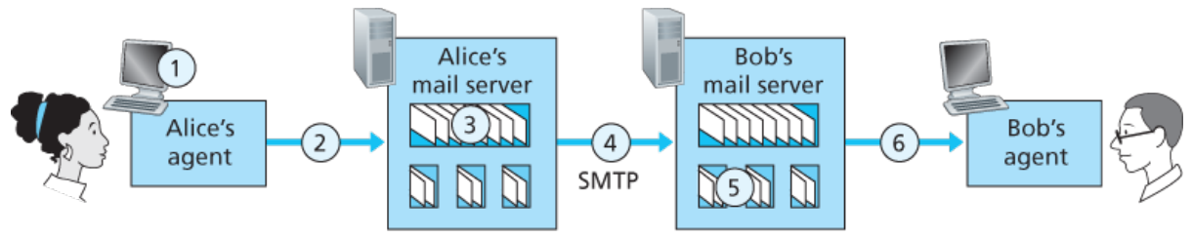

Scenario: Alice sends message to Bob
1) Alice uses UA to compose message “to” bob@someschool.edu
2) Alice’s UA sends message to her mail server; message placed in message queue
3) client side of SMTP opens TCP connection with Bob’s mail server – may fail
4) SMTP client sends Alice’s message over the TCP connection
5) Bob’s mail server places the message in Bob’s mailbox
6) Bob invokes his user agent to read message
**if connection fails, it keeps retrying for few days

Slide 7
Sample SMTP interaction
S: 220 hamburger.edu
C: HELO crepes.fr
S: 250 Hello crepes.fr, pleased to meet you
C: MAIL FROM: <alice@crepes.fr>
S: 250 alice@crepes.fr... Sender ok
C: RCPT TO: <bob@hamburger.edu>
S: 250 bob@hamburger.edu ... Recipient ok
C: DATA
S: 354 Enter mail, end with "." on a line by itself
C: Do you like ketchup?
C: How about pickles?
C: .
S: 250 Message accepted for delivery
C: QUIT
S: 221 hamburger.edu closing connection

Slide 8
SMTP: final words
SMTP uses persistent connections
SMTP requires message (header & body) to be in 7-bit ASCII
SMTP server uses CRLF.CRLF (\r\n.\r\n) to determine end of message
Comparison with HTTP:
HTTP: pull; SMTP: push
HTTP: Server to client; vice versa
SMTP: server to server
both have ASCII command/response interaction, status codes
HTTP: each object encapsulated in its own response message
SMTP: multiple objects sent in multipart message

Slide 9
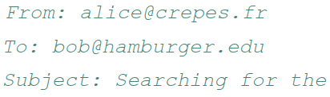
Mail message format
SMTP: protocol for exchanging email messages
RFC 822: standard for text message format:
header lines, e.g.,
different from SMTP MAIL FROM, RCPT TO: commands!
Body: the “message”
ASCII characters only
header
blank
line
body

Slide 10
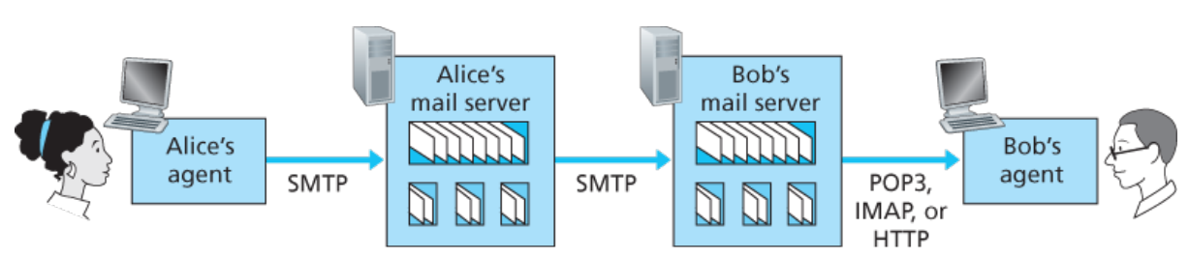
Mail access protocols
SMTP: delivery/storage to receiver’s server
mail access protocol: retrieval from server
POP: Post Office Protocol [RFC 1939]: authorization, download
IMAP: Internet Mail Access Protocol [RFC 1730]: more features, including manipulation of stored messages on server
HTTP: Web based(Gmail, Hotmail, Yahoo! Mail, etc.)

Slide 11
POP3 protocol (Port 110)
S: +OK POP3 server ready
C: user bob
S: +OK
C: pass hungry
S: +OK user successfully logged on
Authorization phase
client commands:
user: declare username
pass: password
server responses
+OK / -ERR
Transaction/update phase
client:
download-&-keep/delete
list: list message # & size
retr: retrieve message by number
dele: delete
quit
After this, mails are deleted from the server.
C: list
S: 1 498
S: 2 912
S: .
C: retr 1
S: <message 1 contents>
S: .
C: dele 1
C: retr 2
S: <message 1 contents>
S: .
C: dele 2
C: quit
S: +OK POP3 server signing off

Slide 12
POP3 (more) and IMAP
More about POP3
Previous example uses POP3 “download and delete” mode
Bob cannot re-read e-mail if he changes client
POP3 “download-and-keep”: copies of messages on different clients
POP3 is stateless across sessions
But maintains state within one session
IMAP
Keeps all messages in one place: at server
Allows user to organize messages in folders
Keeps user state across sessions:
Names of folders and mappings between message IDs and folder name
Can download components of messages

Slide 13
Chapter 2: Outline
Principles of network applications
Web and HTTP
Electronic mail
SMTP, POP3, IMAP
DNS
P2P applications
Video streaming and content distribution networks
Socket programming with UDP and TCP

Slide 14
DNS: domain name system
People: many identifiers:
SSN, name, passport #
Internet hosts, routers:
IP address (32 bit) - used for addressing datagrams
“name”, e.g., www.yahoo.com - used by humans
Q: How to map between IP address and name, and vice versa ?
Domain Name System:
Distributed database implemented in hierarchy of many name servers
Application-layer protocol: hosts, name servers communicate to resolve names (address/name translation)
Note: core Internet function, implemented as application-layer protocol
Complexity at network’s “edge”

Slide 15
DNS: How does it work?
The user machine runs the client side of the DNS application.
The browser extracts the hostname, www.someschool.edu, from the URL and passes the hostname to the client side of the DNS application.
The DNS client sends a query containing the hostname to a DNS server.
The DNS client eventually receives a reply, which includes the IP address for the hostname.
Once the browser receives the IP address from DNS, it can initiate a TCP connection to the HTTP server process located at port 80 at that IP address

Slide 16
DNS: services, structure
DNS services
Hostname to IP address translation *DNS Cache
Host aliasing
Canonical – complicated name!
Alias names – give the canonicals a shorter name!
Can be used to get the canonical name
Mail server aliasing
Web and Mail hostname can be same
Load distribution:
Replicated Web/Mail servers: many IPs correspond to one name
Follows round robin method when distributing IP to user
Why not centralize DNS?
Single point of failure
Traffic volume
Distant centralized database
Maintenance
AND doesn‘t scale!

Slide 17
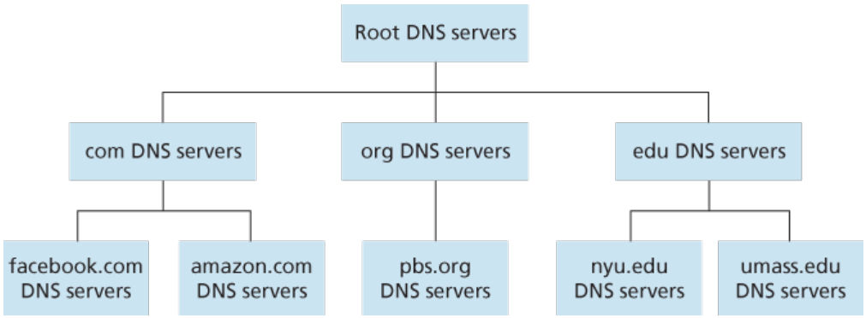
DNS: a distributed, hierarchical database
Client wants IP for www.amazon.com; 1st approximation:
Client queries root server to find the IP of .com DNS server
Client queries .com DNS server to get IP of an authoritative server of amazon.com.
Client queries amazon.com DNS server to get IP address for www.amazon.com

Slide 18
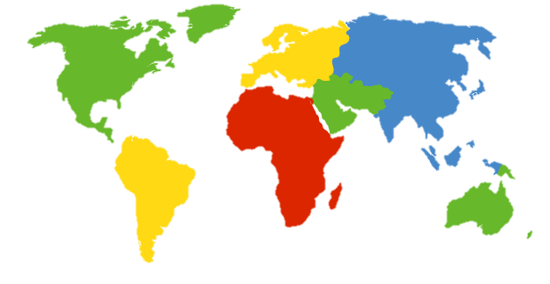
DNS: root name servers
Contacted by local name server that can not resolve name
Root name server:
Contacts authoritative name server if name mapping not known
Gets mapping
Returns mapping to local name server
c. Cogent, Herndon, VA (5 other sites)
d. U Maryland College Park, MD
h. ARL Aberdeen, MD
j. Verisign, Dulles VA (69 other sites )
k. RIPE London (17 other sites)
i. Netnod, Stockholm (37 other sites)
e. NASA Mt View, CA
f. Internet Software C.
Palo Alto, CA (and 48 other sites)
m. WIDE Tokyo
(5 other sites)
13 logical root name “servers” worldwide
each “server” replicated many times
a. Verisign, Los Angeles CA
(5 other sites)
b. USC-ISI Marina del Rey, CA
l. ICANN Los Angeles, CA
(41 other sites)
g. US DoD Columbus, OH (5 other sites)

Slide 19
TLD, authoritative servers
Top-level domain (TLD) servers:
Responsible for com, org, net, edu, aero, jobs, museums, and all top-level country domains, e.g.: uk, fr, ca, jp
e.g. Network Solutions maintains for .com TLD
e.g. Educause for .edu TLD
Authoritative DNS servers:
Organization’s own DNS server(s), providing authoritative hostname to IP mappings for organization’s named hosts
Can be maintained by organization or service provider

Slide 20
Local DNS name server
Does not strictly belong to hierarchy
Each ISP (residential ISP, company, university) has one
Also called “default name server”
When host makes DNS query, query is sent to its local DNS server
Has local cache of recent name-to-address translation pairs (but may be out of date!)
Acts as proxy, forwards query into hierarchy

Slide 21
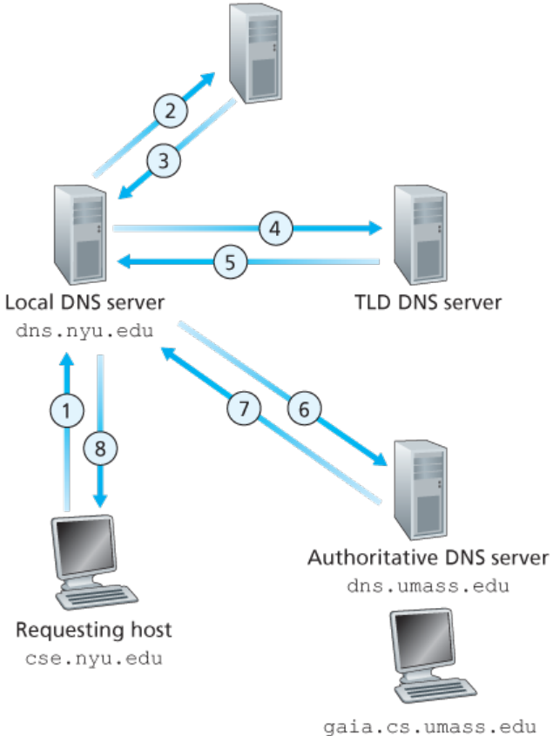
DNS name resolution example
Host at cis.poly.edu wants IP address for gaia.cs.umass.edu
Iterated query:
Contacted server replies with name of server to contact on the next level
Root points to TLD, TLD then points to authoritative.

Slide 22
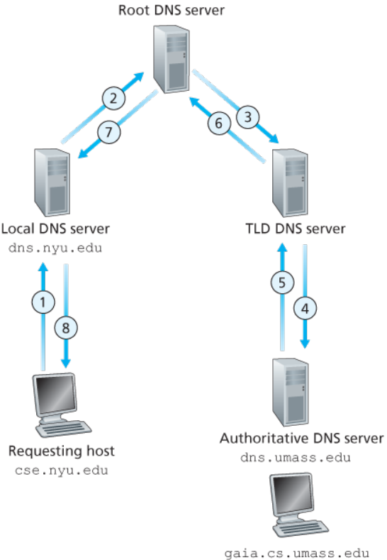
DNS name resolution example
Recursive query:
Puts burden of name resolution on contacted name server
Heavy load at upper levels of hierarchy?

Slide 23
DNS: caching, updating records
Once (any) name server learns mapping, it caches mapping
Cache entries timeout (disappear) after some time (TTL)
TLD servers typically cached in local name servers
thus root name servers not often visited
Cached entries may be out-of-date (best effort name-to-address translation!)
if name host changes IP address, may not be known Internet-wide until all TTLs expire
Update/notify mechanisms proposed IETF standard
RFC 2136

Slide 24
DNS records
DNS: Distributed database storing resource records (RR)
RR format: (name, value, type, ttl)
type=A
Name is hostname
Value is IP address
(relay1.bar.foo.com, IP, A)
type=CNAME
Name is alias name for some “canonical” (the real) name
Value is canonical name
(ibm.com, server.backup.ibm.com, CNAME)
type=NS
Name is domain
Value is hostname of authoritative name server for this domain
(fi.com, dns.fi.com, NS)
**e.g. MX and NS can be use to map same domain to multiple server
type=MX
Value is name of mail server associated with name
(fi.com, mail.fi.com,MX)

Slide 25
Inserting records into DNS
Example: new startup “Network Utopia”
Register name networkuptopia.com at DNS registrar (e.g., Network Solutions)
Provide names, IP addresses of authoritative name server (primary and secondary)
Registrar inserts two RRs into .com TLD server: (networkutopia.com, dns1.networkutopia.com, NS)
(dns1.networkutopia.com, 212.212.212.1, A) (dns1.networkutopia.com, mail.networkutopia.com, MX)
Create authoritative server type A record for www.networkuptopia.com; type MX record for mail.networkutopia.com

Slide 26
Attacking DNS
Redirect attacks
man-in-middle
Intercept queries
DNS poisoning
Send bogus replies to DNS server, which caches
Exploit DNS for DDoS
send queries with spoofed source address: target IP
requires amplification
DDoS attacks
Bombard root servers with traffic
not successful to date
traffic filtering
local DNS servers cache IPs of TLD servers, allowing root server bypass
Bombard TLD servers
potentially more dangerous

